Slide 1
Finance and Risk Analytics
Capstone Project – Jay Bhanupratap Thakur

Slide 2
Index
Problem Statement
Final Dataset Snippet
Visualization
Pair plot based on Returns of each stocks
Line Graph based on Returns of stocks
Distribution plot based on Return from stocks
Heatmap Subplots based on Return
Statistical visualization based on Returns of each stocks
Profiling
Profile 1 -> Patrick
Creating new dataframe and finding Correlation between stocks using Heatmap
Calculating cumulative return of the stocks selected for Patrick
Statistical understanding based on Cumulative Returns of each stocks selected for Patrick
Profile 2 -> Peter
Creating new dataframe and finding Correlation between stocks using Heatmap for Peter
Calculating cumulative return of the stocks selected for Peter
Statistical understanding based on Cumulative Returns of each stocks selected for Peter

Slide 3
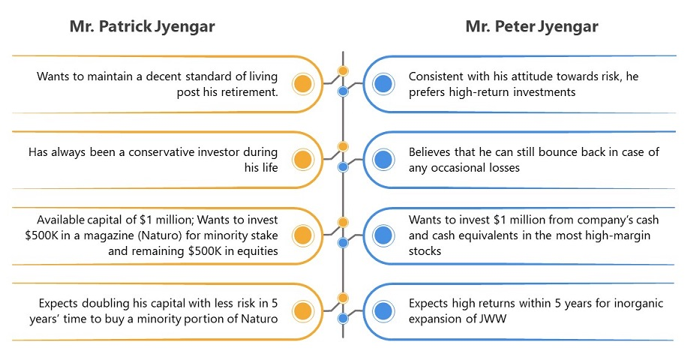
Problem Statement
The given task is to provide consultation to two different investors, Mr. Patrick Jyenger and Mr. Peter Jyenger based on their requirements and financial objectives.

Slide 4
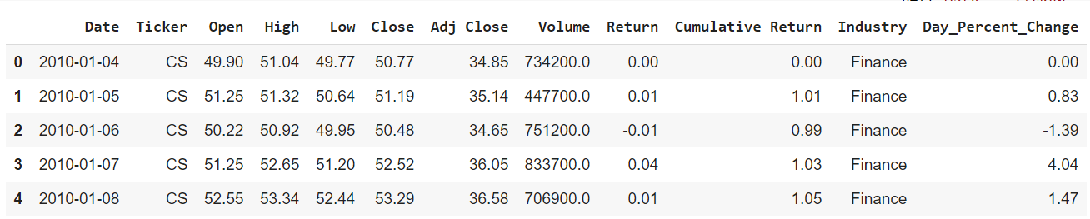
Final Dataset
After cleaning and creating new columns we were able to draw final dataset that contains all the columns such as –
Ticker/Stock,
Their high/low/close/open price,
return/cumulative return,
industry they belong to and
day percent change in their price

Slide 5
Visualization

Slide 6
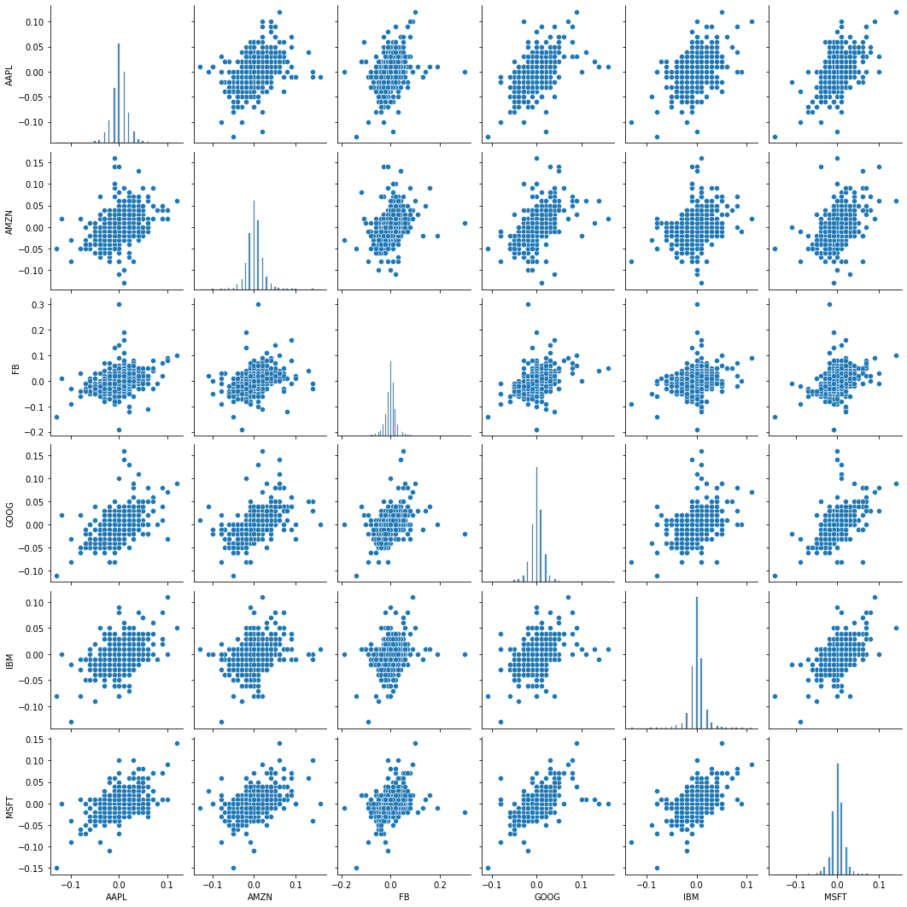
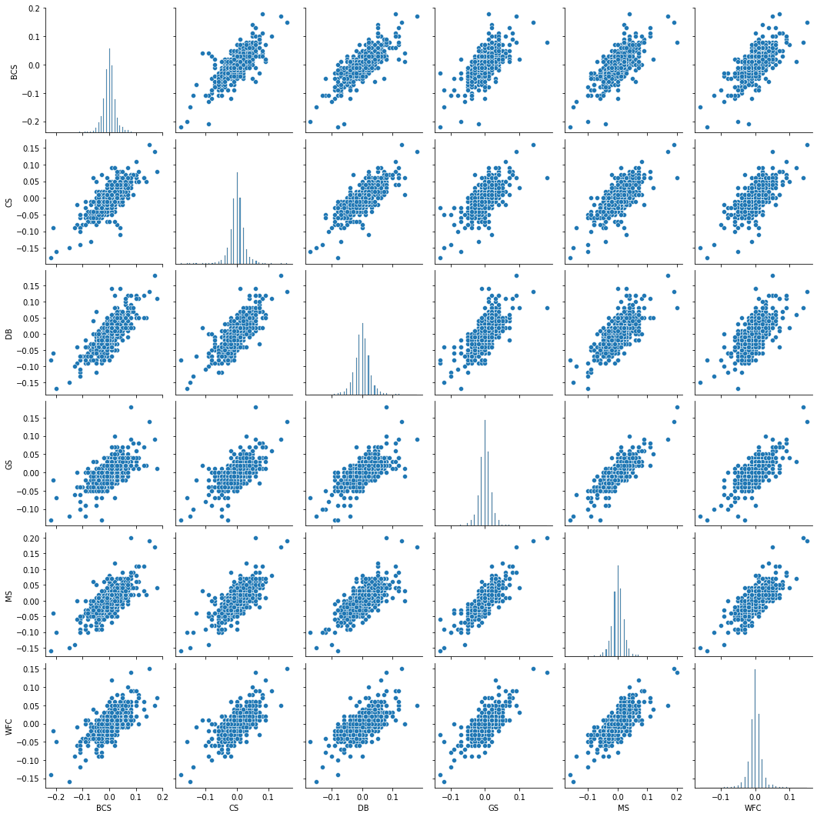
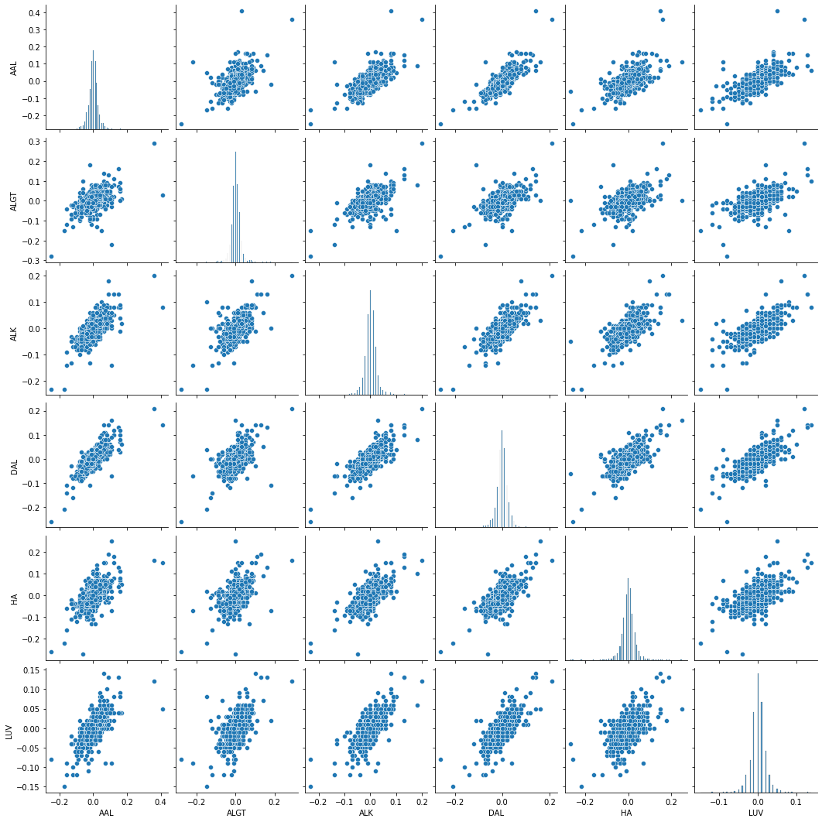
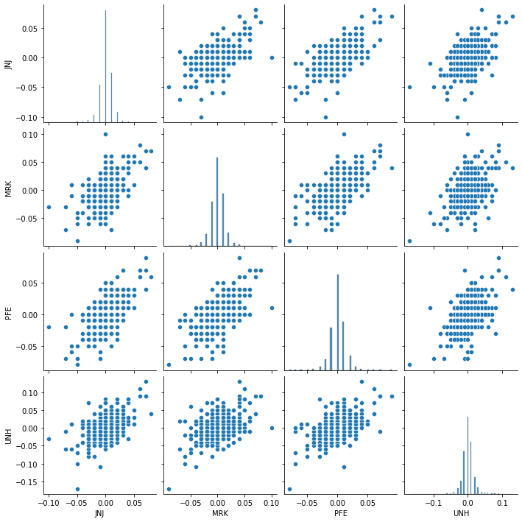
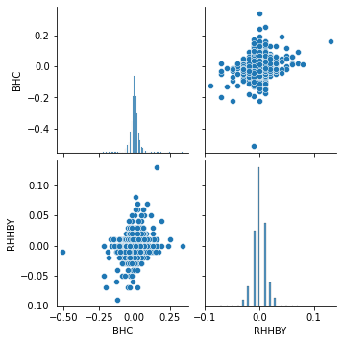
Pair plot Visualization
Technology
Finance
Technology
All Tickers or Stocks such as MSFT-AAPL, IBM-AMZN, AAPL-GOOG, GOOG-IBM, etc. show positive correlation i.e. as one increases other also increases or vice versa.
Finance
All Tickers or Stocks show positive correlation i.e. as one increases other also increases or vice versa.
Aviation
Some tickers or stocks show positive correlation i.e. as one increases other also increases or vice versa. Some tickers do not show any relationship.
Healthcare
Some tickers or stocks show positive correlation i.e. as one increases other also increases or vice versa.
Some tickers like UNH with any other Healthcare Industry stocks do not show any relationship.
Pharmaceuticals
No tickers show any correlation.
Aviation
Healthcare
Pharmaceuticals

Slide 7
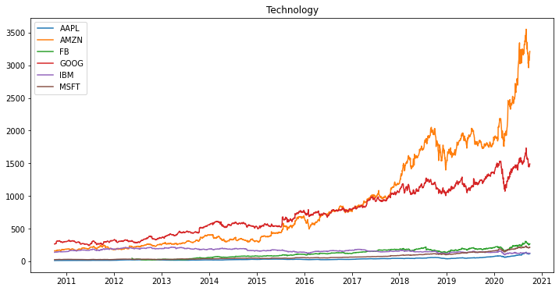
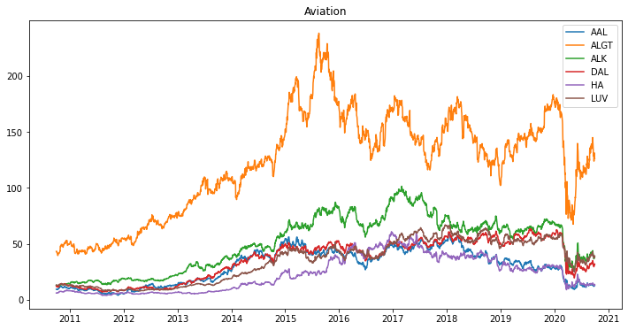
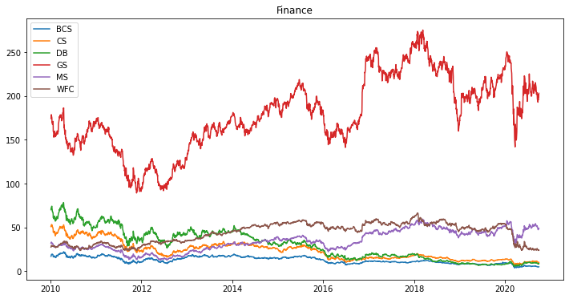
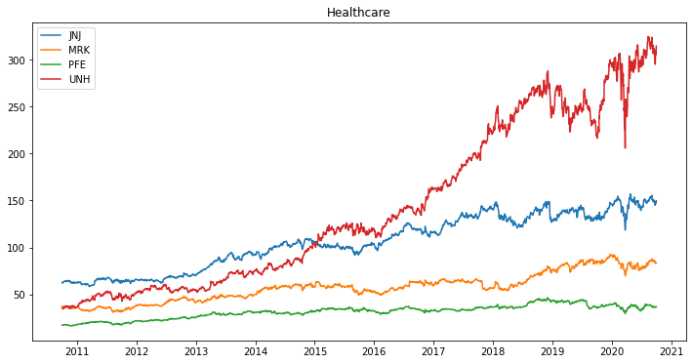
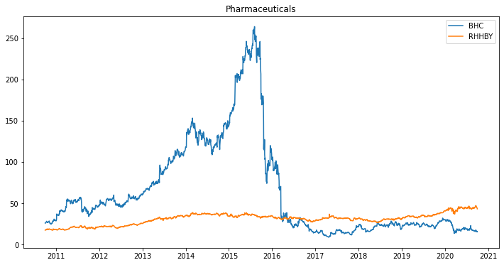
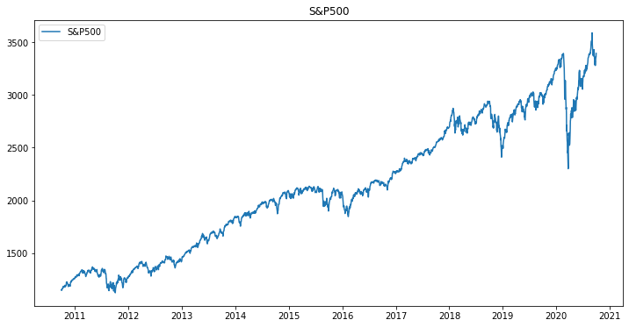
Line Graph Visualization
High & Low Price
By observing both High and Low price of tickers or stocks of different Industries over the period of 10 years we could conclude that
In Tech industry mentioned tickers have highest performance
AMZN
GOOG
In Finance industry mentioned tickers have highest performance
GS
In Aviation industry mentioned tickers have highest performance
ALGT
In Healthcare industry mentioned tickers have highest performance
UNH
JNJ
In Pharmaceuticals none of the tickers have performed well.
All the ticker belonging to different industries show a sudden dip in their performance in between the year 2020 to 2021.
The low performance of stocks after year 2020 must be due to the affect of Pandemic caused my the spread of COVID-19.

Slide 8
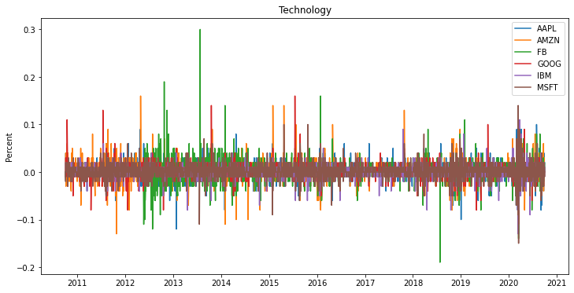
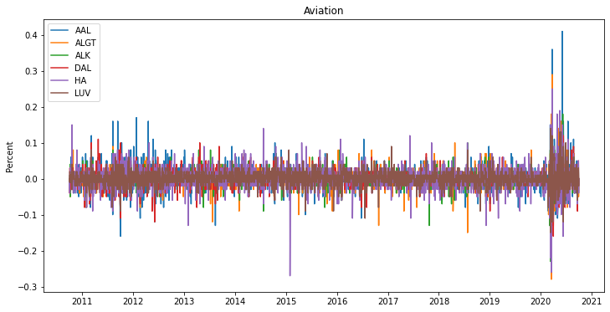
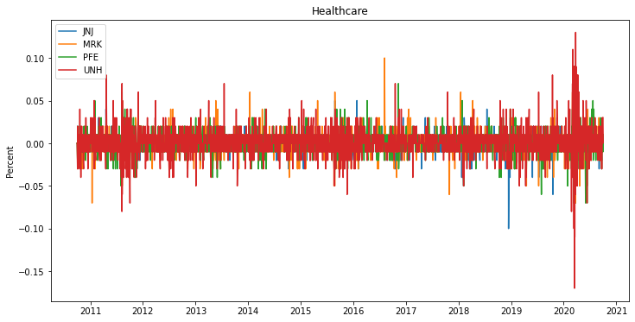
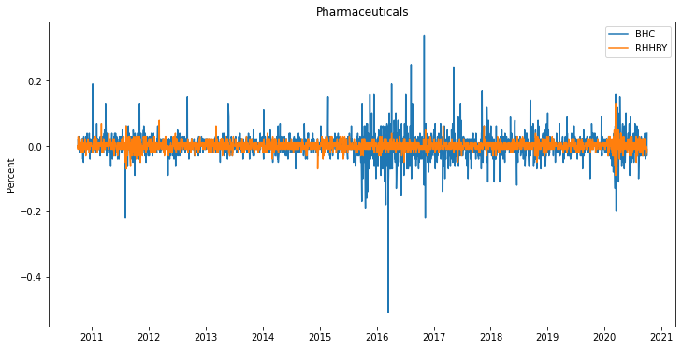
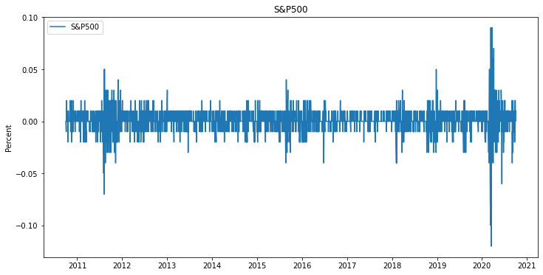
Line Graph Visualization
Return
After looking at the daily returns chart for Finance, Aviation and Technology industry stocks, we can conclude that the returns are quite volatile and the stock can move +/- 10% on any given day.
Pharmaceuticals industry returns are quite low daily return as compared to other industry stocks.
After 2015 we can see rise in daily return for Pharma industry.
Healthcare industry has worst daily returns i.e. +/- 1% on a given day, but we can see a spike after year 2020 in this industry mostly because of Pandemic.
All stocks of different industry show sudden spike after year 2020.

Slide 9
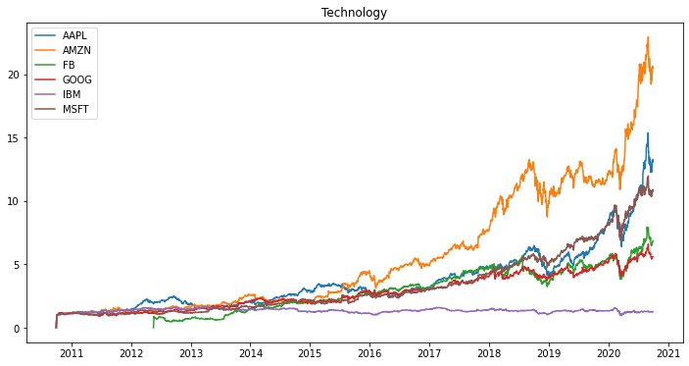
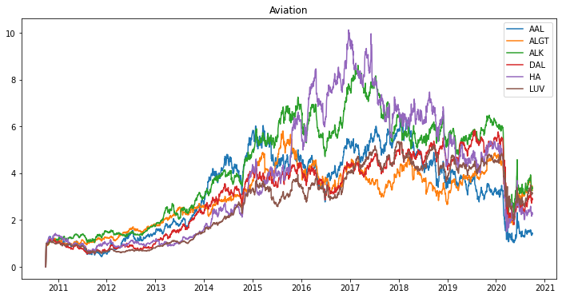
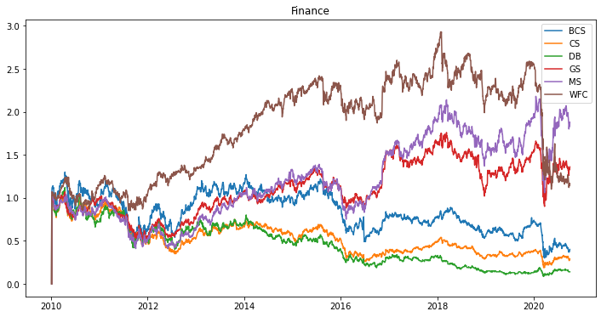
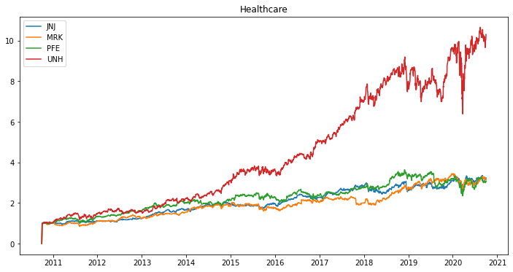
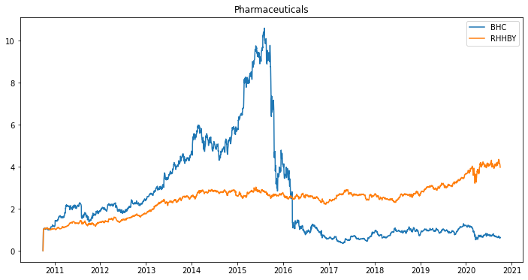
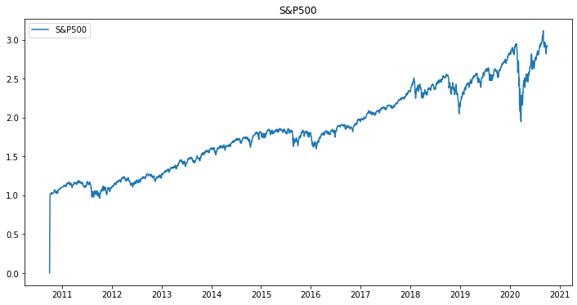
Line Graph Visualization
Cumulative Return
We can see for Finance industry the Cumulative Return for the span of 10 years shows that stocks like `GS, MS and WFC` haven't performed well with cumulative return range between 1% to less than 3%.
In Aviation industry the cumulative return moves between 1% to 10% for span of a decade.
For Pharmaceuticals industry the cumulative return ranged from 1% to 10% till halve of 2015 but after sudden drop in other halve of 2015 it ranged from 1% to just 4%
Technology industry stocks have highest Cumulative return for last 10 years with range of 1 % to more than 25%, except the `IBM` stock with cumulative return of just 1% for 10 years.
In Healthcare industry, the only well performing stock is `UNH` with cumulative range between 1% to more than 11% otherwise other stocks have cumulative range below 3%.

Slide 10
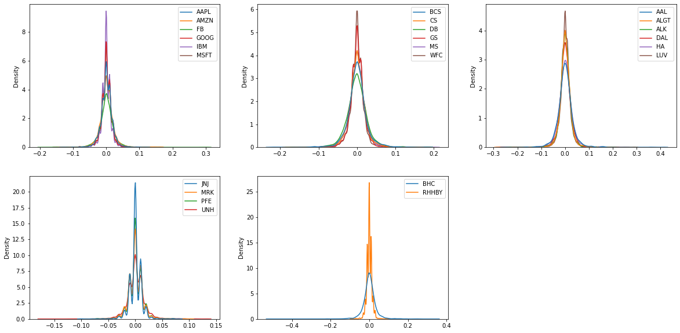
KDE Visualization
Technology:
AMZN and AAPL have peak towards positive side followed by MSFT and GOOG that means investing in this while have high and positive returns, unlike IBM have constant even after longer time investment.
Finance:
CS, BCS and GS have peak towards positive side that means investing in this while have high and positive returns after longer period of investment.
Aviation:
AAL, DAL, LUV and AKL have peak towards positive side that means investing in this while have high and positive returns after longer period of investment.
Healthcare:
JNJ and MRK have peak towards positive side that means investing in this while have high and positive returns after longer period of investment.
Pharmaceuticals:
The spread of curve for BHC shows that the return will be constant even spread for longer period and in case of `RHHBY` the return will be less than 0 even for longer time investment.

Slide 11
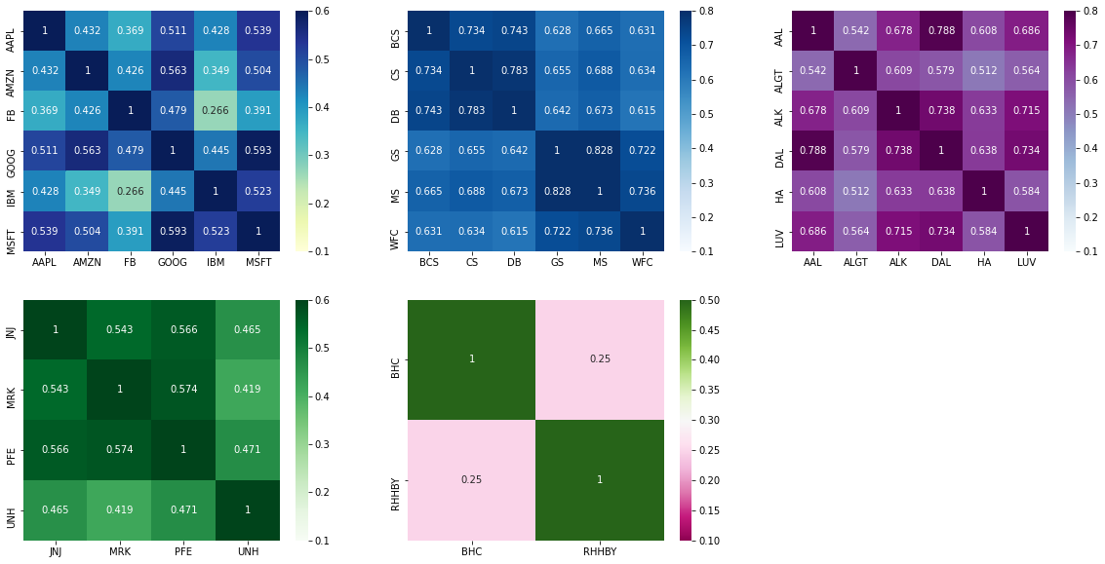
Heatmap Visualization
For Technology industry below mentioned stocks have high correlation and combined can give high returns.
MSFT-AAPL, MSFT-AMZN, MSFT-GOOG, MSFT-IBM
GOOG-AAPL, GOOG-AMZN
For Finance industry below mentioned stocks have high correlation and combined can give high returns.
DB-CS-BCS
GS-MS-WFC
For Aviation industry below mentioned stocks have high correlation and combined can give high returns.
AAL-DAL, AAL-LUV
ALK-LUV, ALK-AAL, ALK-DAL
DAL-LUV
For Healthcare industry below mentioned stocks have high correlation and combined can give high returns.
PFE-JNJ-MRK
In Pharmaceuticals there seems to be no correlation between any stock. Hence, not recommended to invest in any stocks of this industry.
NOTE-Two stocks that are highly correlated, among both investing in any one is suggested as they both have same return pattern

Slide 12
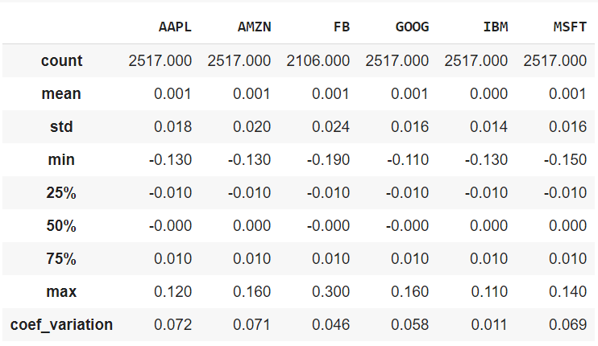
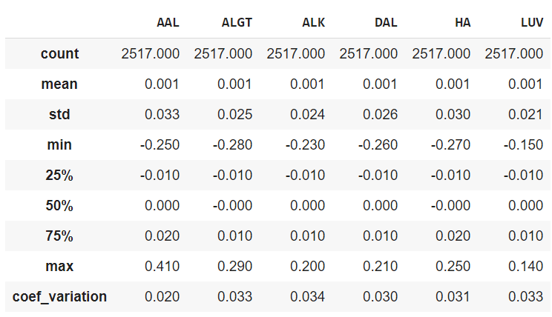
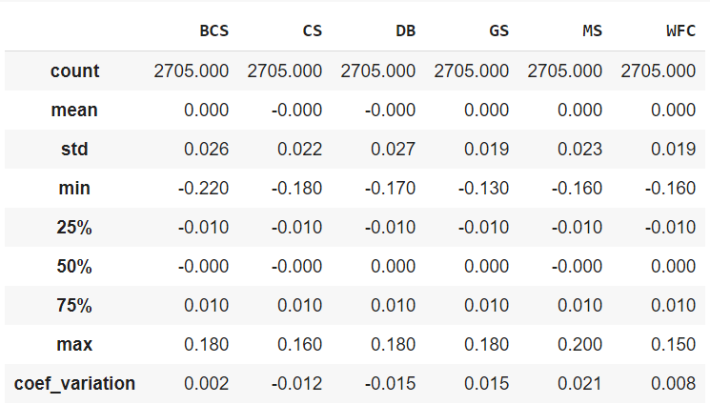
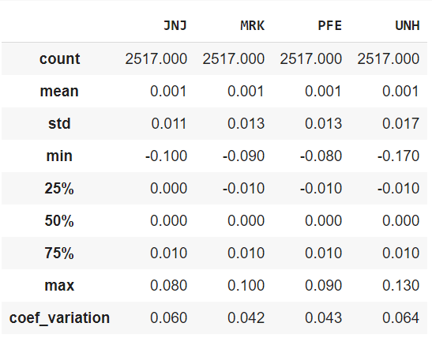
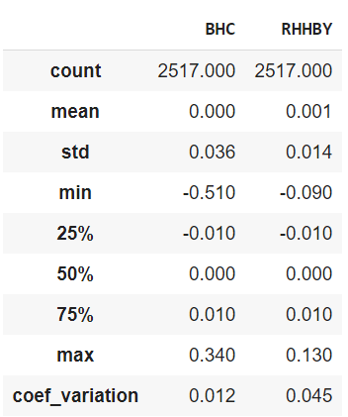
Statistical Visualization
Technology
Aviation
Finance
Healthcare
Technology:
Stocks like AAPL, AMZN and MSFT have high coef_variation and std values. Hence, we can select these three for client who is okay with high risk stocks, but also wants high return from them.
Finance:
In finance industry all the stocks show poor coef_variation and std values which says that though there is low risk in these stocks but the return from these will also be low or one could loss their investment.
Healthcare:
After visualizing and understanding Healthcare industry stocks on the basis of coef_variation and std values `JNJ and UNH` must suggested for the investment as these have high risk with high return in this industry stocks.
Aviation:
Looking at the coef_variation and std values of stocks, clients willing to take less risk for sufficient return of investment must invest in these ALK, ALGT and LUV stocks
Pharmaceuticals:
Though there are only two stocks in Pharmaceuticals industry, if client wants to invest in the stocks of this industry than RHHBY must be choose for investment, but std value also suggest that return could be low
Pharmaceuticals

Slide 13
Profiling

Slide 14
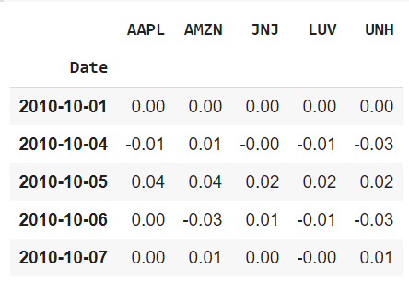
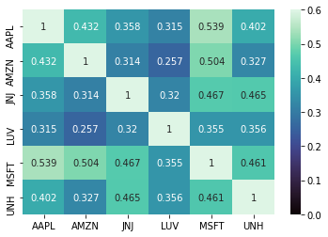
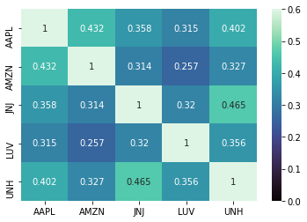
Profile 1 -> Patrick
Patrick Portfolio Stocks
Patrick Portfolio & Heatmap
_{Heatmap:}
MSFT stock seems to highly correlated with AAPL and AMZN so we could drop either of the stocks. In this we are going to drop MSFT as it low return and cumulative return when compared with AAPL and AMZN stocks.
Before removing MSFT
After removing MSFT

Slide 15
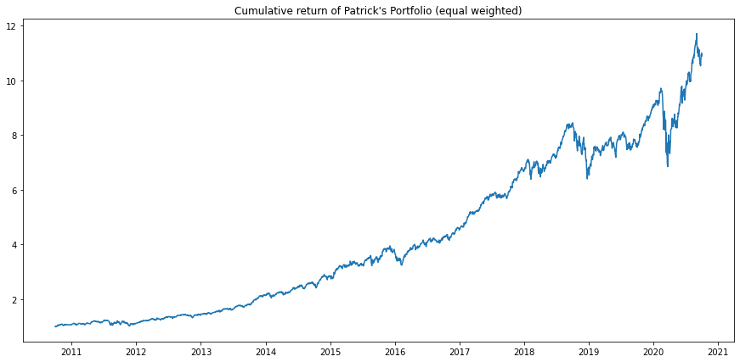
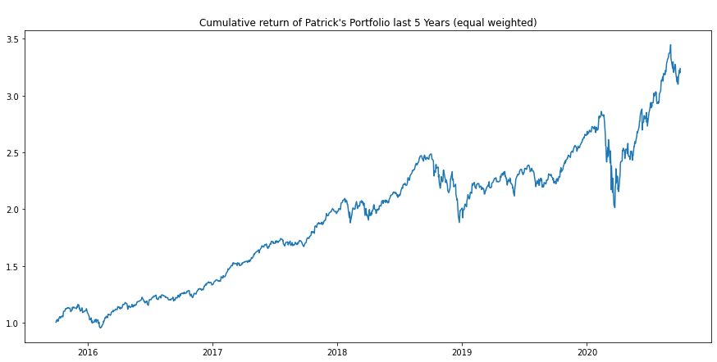
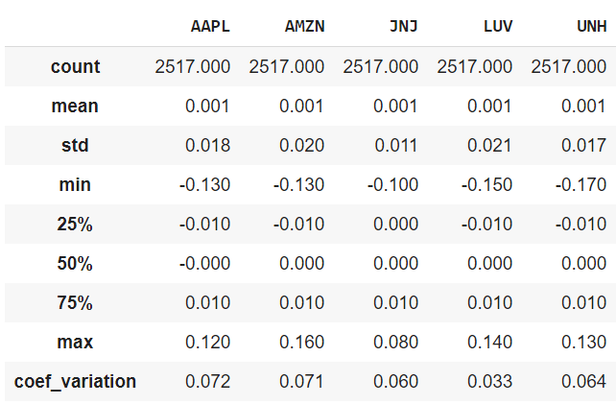
Cumulative return Line plot
Both plots in slide 8 and 9 show that stocks can provide high return.
Statistical view confirms that all these stock have high coef_variation that means these stocks could provide high or sufficient return on investment, but low std means they also have low risk associated with them.
Based on the plotting and statistical representation we could conclude these are the best for the Patrick and clients having similar profile.
A dip after 2020 could be due to spread of Pandemic affecting closing of various businesses all over the World.

Slide 16
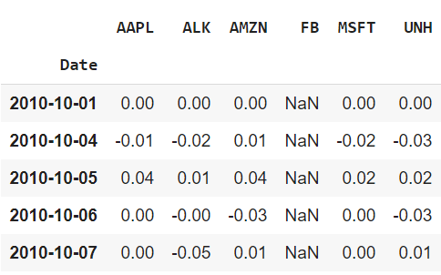
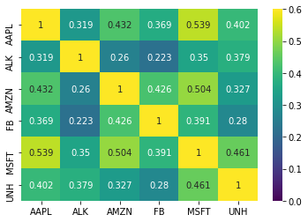
Profile 2 -> Peter
Peter Portfolio Stocks
Peter Portfolio & Heatmap
This is the final portfolio combined with AAPL, ALK, AMZ, FB, MSFT, UNH stocks best for client profile similar to Peter.
All the stocks seems to be properly diversified and this is an optimum portfolio for Peter to invest in.
Correlation matrix

Slide 17
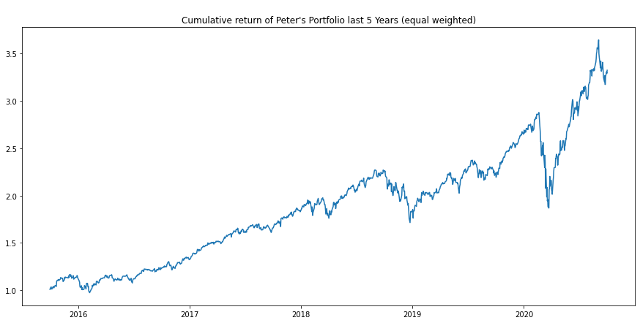
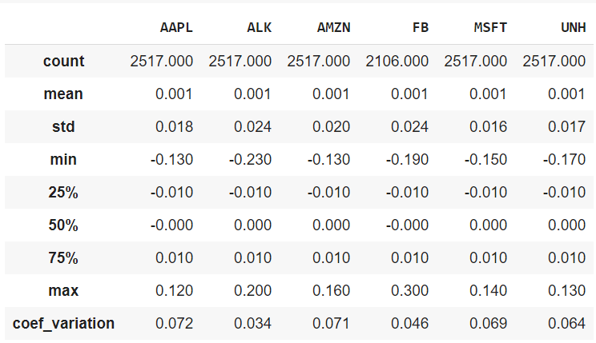
Cumulative return Line plot
Both plots in slide 8 and 9 show that stocks can provide high return.
Statistical view confirms that all these stock have high coef_variation that means these stocks could provide high return on investment, but high std means they also have high risk associated with them.
Though FB has low coef_variation but it could return high return if invested for longer period which could be confirmed for Cumulative Return or Return plotting in 3.2 and 3.3 steps.
Based on the plotting and statistical representation we could conclude these are the best for the Patrick and clients having similar profile.
A dip after 2020 could be due to spread of Pandemic affecting closing of various businesses all over the World.

Slide 18
Thank You

